Slide 1
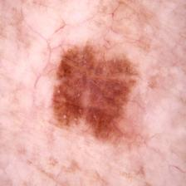
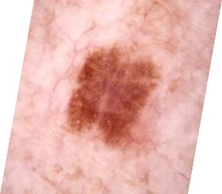
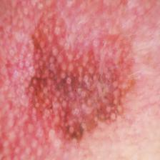
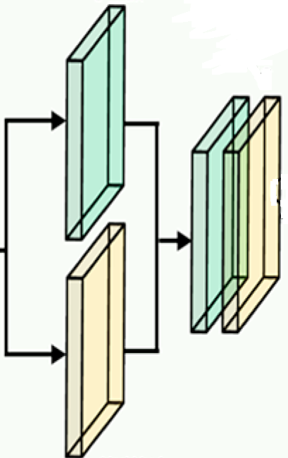
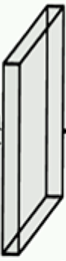
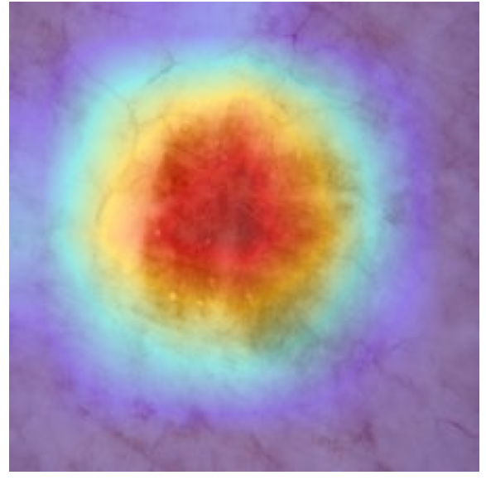
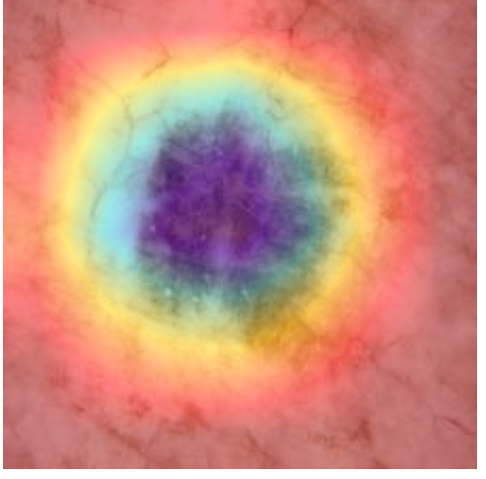



Training Augmentation
Xception Model (Pretrained on ImageNet, First 50 Layers Frozen)
Entry Flow
Training Augmentation
Keras Model
Pretrained on ImageNet
3×3 SCONV
3×3 SCONV
3×3 CONV
3×3 CONV
ReLU
MaxPool
3×3 SCONV
3×3 SCONV
3×3 SCONV
ReLU
ReLU
ReLU
ReLU
MaxPool
ReLU
3×3 SCONV
Input: 224×224×3
ReLU
MaxPool
Input: 224×224×3
Rotate 15°
Zoom 15%
Shear 10%
Horizontal Flip
Rotate 15°
Zoom 15%
Shear 10%
Width Shift 15%
Height Shift 15%
Width Shift 15%
Horizontal Flip
1×1
CONV
1×1
CONV
1×1
CONV
Height Shift 15%
Apply CLAHE
Clip Limit = 1%
ReLU
Preprocess Input
Softmax Layer
ReLU
3×3 SCONV
3×3 SCONV
MaxPool
ReLU
ReLU
3×3 SCONV
Classified Output
Fully Connected Layer
ReLU
ReLU
3×3 SCONV
3×3 SCONV
ReLU
….
….
Global avg pooling
(7, 7, 2048) feature map
3×3 SCONV
Middle Flow (Repeat 8 Times)
ReLU
Resize: 224×224×3
7 unit
$$128 unit$$
1×1 CONV
3×3 SCONV
Resize: 224×224×3
Exit Flow
Max pooling
H×W×1
Feature: H×W×C
Global max pooling
C/16
C
Global max pooling
Feature: H×W×C
Concatenation
H×W×2
H×W×1
CBAM
Features
1×1×C
Convolutional
7×7
H×W×C
CBAM Block
Global avg pooling
Global avg pooling
Convolutional
Feature H×W×1
1×1×C
Shared Dense
Layer
Avg pooling H×W×1
Channel Attention Module
Spatial Attention Module
Element-wise Addition
Element-wise Product
Sigmoid Activation
Softmax Layer
ReLU
Last Conv Layer
Feature Map
Softmax
Output
Classified Output with
Confidence Score
….
Dropout = 0.25
….
Dropout = 0.3
Global avg pooling
GradCAM++ Visualization
$n_{c}$ unit
$$128 unit$$
L1=1e-4, L2=1e-3
CBAM Attention
Map Visualization
Fully Connected Layer

